Slide 1
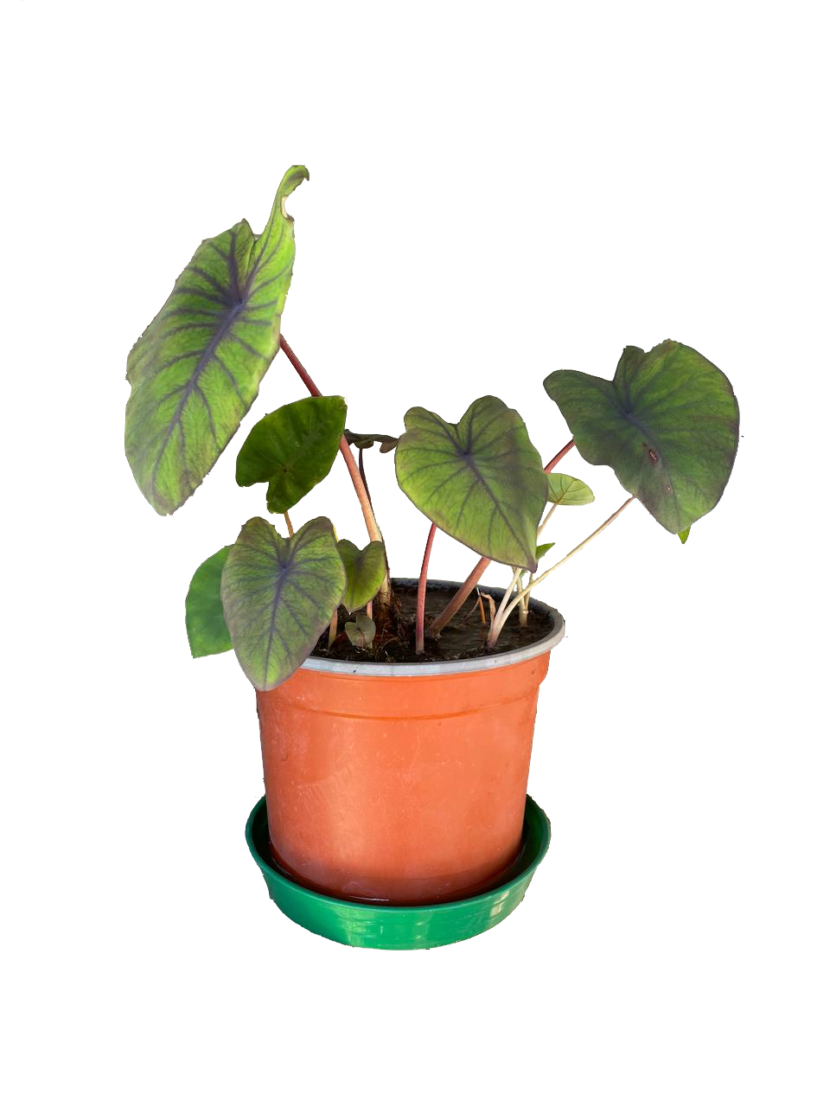
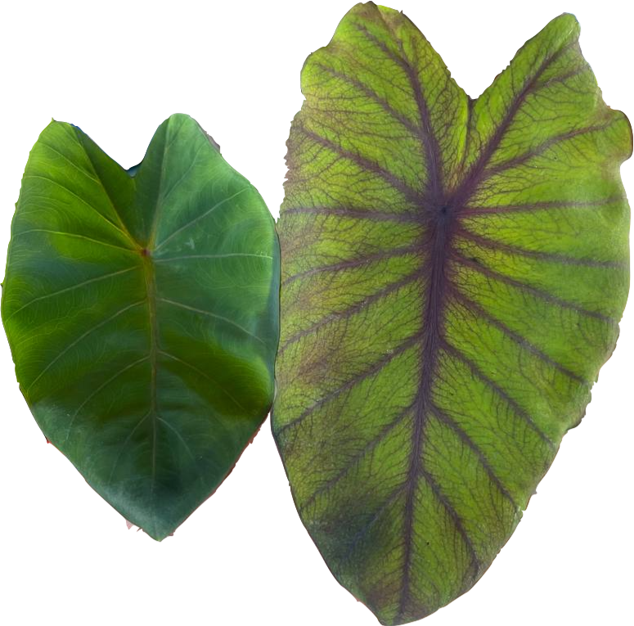


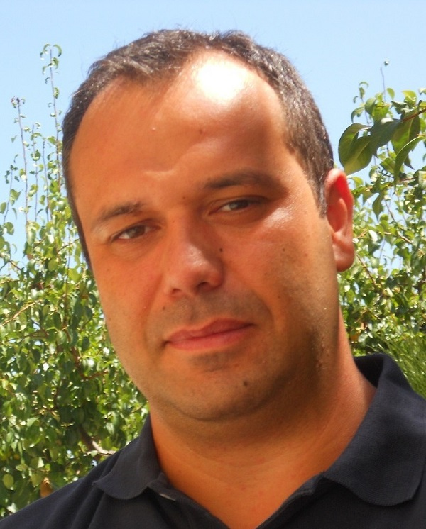
Plant Biosensor
University of Trento in collaboration with STMicroelectronics
ST Sustainability Days, Agrate Brianza 4° of May 2023
University of Trento Department of Industrial Engineering (DII)
Prof. Davide Brunelli, davide.brunelli@unitn.it
Matteo Nardello, Ph.D., matteo.nardello@unitn.it
Maria Doglioni, Ph.D. student, maria.doglioni@unitn.it
STMicroelectronics
Ing. Roberto La Rosa, IC Mixed Signal Senior Principal Designer roberto.larosa@st.com
Ing. Luisa Fracassini, Sustainability & Open Innovation Manager luisa.fracassini@st.com
Torrisi, A. et al. (2023). Batteryless Soil EIS Sensor Powered by Microbial Fuel Cell. In: Proceedings of SIE 2022. SIE 2022. Lecture Notes in Electrical Engineering, vol 1005. Springer, Cham. https://doi.org/10.1007/978-3-031-26066-7_43
Brunelli D. et al. Long range wireless sensing powered by plant-microbial fuel cell doi: 10.23919/DATE.2017.7927258.
Maria Doglioni
Matteo Nardello
Prof. Davide Brunelli

Slide 2
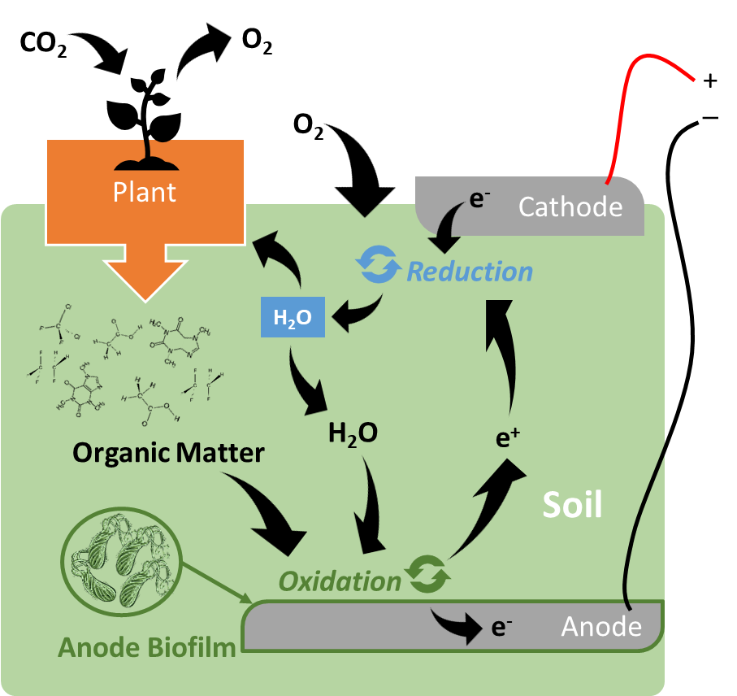

PLANT MICROBIAL FUEL CELLS – ENERGY HARVESTING SOURCE
Based on exoelectrogenic bacteria naturally present in the soil.
Presence of plant ensures bacteria are fed.
Potentially generates electricity as long as plant lives.
Challenges:
Voltage reversal
Electrobiochemical optimization needed
Low voltage
Low current
Short cell life
Long start up time

Slide 3
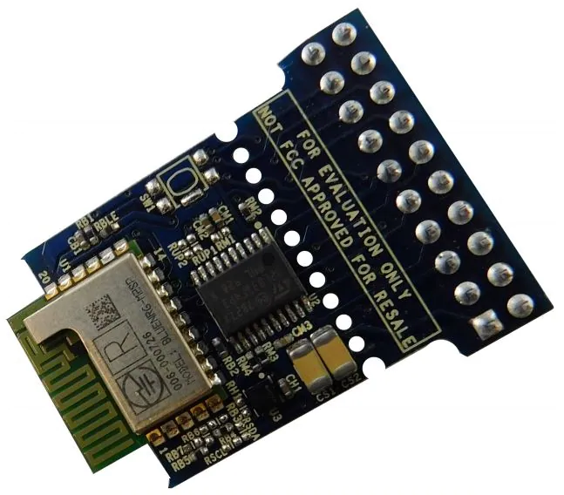
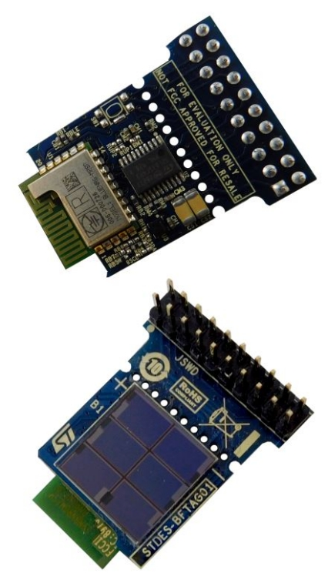
STDES-BFTAG01 – AUTONOMOUS BLE SENSOR
Ing. Roberto La Rosa, STMicroelectronics
BLE beacon
Wait time
Fully autonomous: operates only with harvested energy.
Senses temperature and humidity.
Transmits 6 Bluetooth Low Energy (BLE) beacons every 20 seconds, if energy is available.
Tag transmission frequency is related to harvested power.

Slide 4
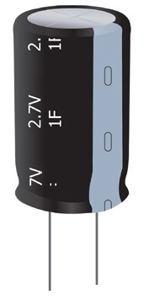





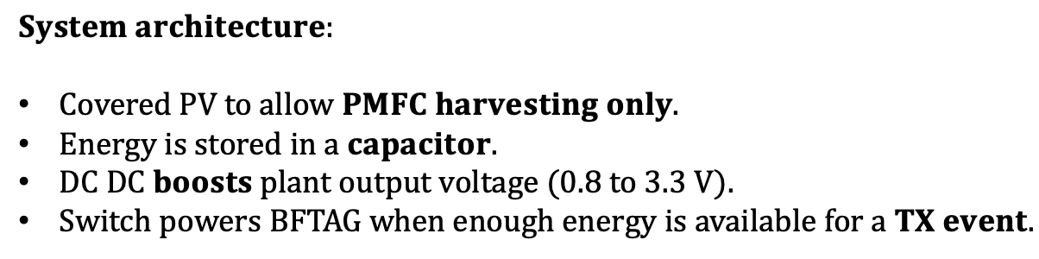
POWERING THE BLE SENSOR WITH A PMFC
$$V_{BAT,OK}$$
Load switch
$$V_{STOR}$$
$$V_{DD,TAG}$$
Storage capacitor
$$DC DC converter$$
$$V_{BAT,OK}$$
Energy harvested from the PMFC is stored in a capacitor.
Covered PV to allow PMFC harvesting only.
DC DC boosts plant output voltage (0.8 to 3.3 V).
Switch powers BFTAG when enough energy is available
PMFC
BFTAG01
$$System architecture:$$
$Covered PV to allow PMFC harvesting only$.
$Energy is stored in a capacitor.$
$DC DC boosts plant output voltage (0.8 to 3.3 V).$
$Switch powers BFTAG when enough energy is available for a TX event.$

Slide 5





TESTING THE SYSTEM
PMFC BLE sensor tag
BLE beacon
Phone + STPVTAG app
$$+$$
TRY IT YOURSELF!
Search BFTAG on Google Play or scan this QR code
$$System architecture:$$
$Covered PV to allow PMFC harvesting only$.
$Energy is stored in a capacitor.$
$DC DC boosts plant output voltage (0.8 to 3.3 V).$
$Switch powers BFTAG when enough energy is available for a TX event.$

